Slide 1
Thread-Level Parallelism Coherence
11
Kai Bu
kaibu@zju.edu.cn
http://list.zju.edu.cn/kaibu/comparch2021
Notes:
So today, we are going to cover the last topic of this course, multiprocessors

Slide 2
ILP -> TLP
instruction-level
parallelism
thread-level
parallelism
Notes:
All our previous discussions are based on a single processor,
where when we consider about exploring parallelism to speed up computer execution,
we pipeline a series of instructions.
But by multiprocessor, we can propel parallelism from instruction level to thread level.

Slide 3
ILP -> TLP
instruction-level
parallelism
thread-level
parallelism
TLP is identified by software or programmer and threads consist of (parallel) instructions
Notes:
All our previous discussions are based on a single processor,
where when we consider about exploring parallelism to speed up computer execution,
we pipeline a series of instructions.
But by multiprocessor, we can propel parallelism from instruction level to thread level.
Although the amount of computation assigned to a thread, called the grain size, is important in considering how to exploit thread-level parallelism efficiently, the important qualitative distinction from instruction-level parallelism is that thread-level parallelism is identified at a high level by the software system or programmer and that the threads consist of hundreds to millions of instructions that may be executed in parallel.

Slide 4
MIMD multiple instruction streams multiple data streams
Each processor fetches its own instructions and operates on its own data
Notes:
Using a multiprocessor architecture, a computer can simultaneously work on multiple instruction streams as well as multiple data streams.
Each processor can fetch its own instructions and operate on its own data.

Slide 5
multiprocessors multiple instruction streams multiple data streams
computers consisting of tightly coupled processors
Coordination and usage are typically controlled by a single OS
Share memory through a shared address space
Notes:
All the processors share the same memory
and their coordination are typically controlled by a single operating system.

Slide 6
multiprocessors multiple instruction streams multiple data streams
computers consisting of tightly coupled processors
Muticore Single-chip systems with multiple cores
Multi-chip computers each chip may be a multicore sys
Notes:
According to how processors are integrated, there are two types of multiprocessor architectures.
The first one is multicore computers, they use a single chip integrated with multiple cores.
While the second type, multi-chip computers have multiple chips, each might be a multicore system.

Slide 7
Exploiting TLP
two software models
Parallel processing
the execution of a tightly coupled set of threads collaborating on a single task
Request-level parallelism
the execution of multiple, relatively independent processes that may originate from one or more users
Notes:
Such systems exploit thread-level parallelism through two different software models.
The first is the execution of a tightly coupled set of threads collaborating on a single task, which is called parallel processing;
The second is the execution of multiple, relatively independent processes that may originate from one or more users, which is called request-level parallelism.
Request-level parallelism may be exploited by a single application running on multiple processors, such as a database responding to queries, or multiple applica- tions running independently, often called multiprogramming.

Slide 8
Outline
Multiprocessor Architecture
Centralized Shared Memory
Distributed Shared Memory
Notes:
Next, we’ll first introduce the multiprocessor architecture;
After that, we’ll discuss how different processors manage memory in centralized and distributed fashion.
For distributed shared memory, we also introduce how data coherence across different processors is maintained.

Slide 9
Outline
Multiprocessor Architecture
Centralized Shared Memory
Distributed Shared Memory
Notes:
First, the multiprocessor architecture

Slide 10
Multiprocessor Architecture
According to memory organization and interconnect strategy
Two classes
symmetric/centralized shared-memory multiprocessors (SMP)
+
distributed shared memory multiprocessors (DMP)
Notes:
According to how the memory is shared and how processors interconnect with each other, multiprocessor architecture can be classified into two classes.
Centralized shared-memory multiprocessors and distributed shared memory multiprocessors.

Slide 11
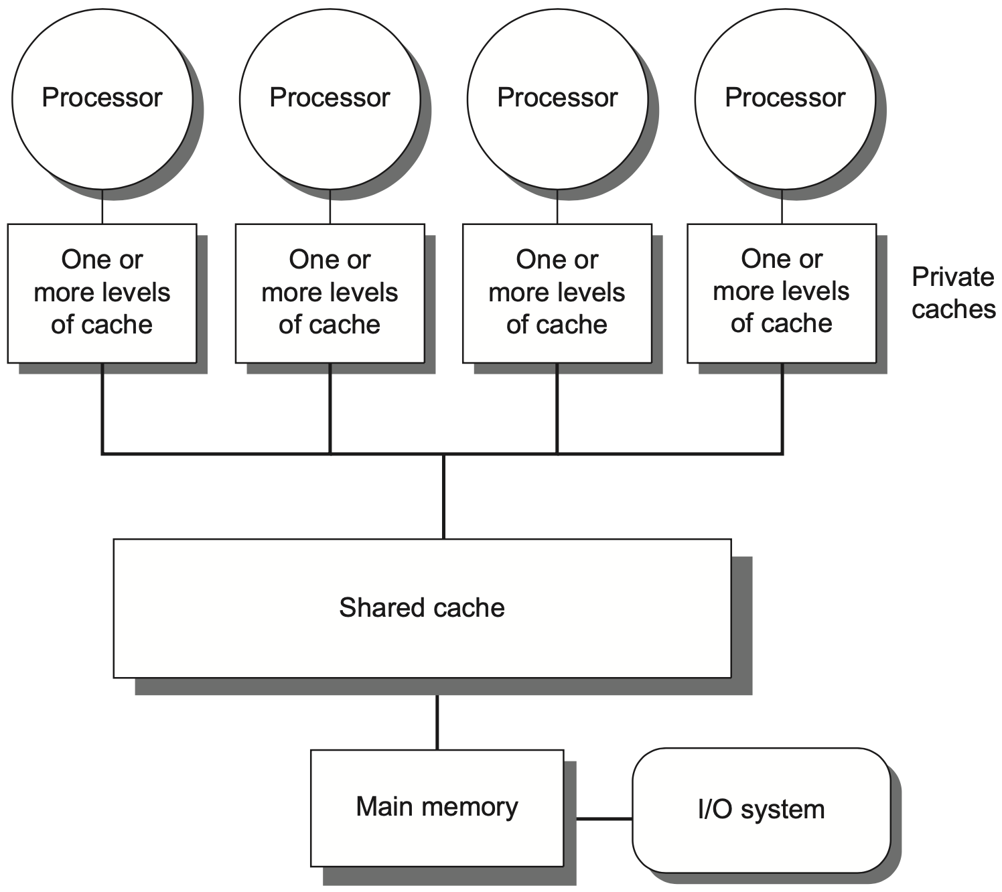
Centralized Shared-Memory
32 or fewer cores
Notes:
Centralized shared-memory multiprocessors usually feature eight or fewer cores.
Each processor has its own cache.
Figure 5.1 Basic structure of a centralized shared-memory multiprocessor based on a multicore chip. Multiple processor-cache subsystems share the same physical mem- ory, typically with one level of shared cache on the multicore, and one or more levels of private per-core cache. The key architectural property is the uniform access time to all of the memory from all of the processors. In a multichip design, an interconnection net- work links the processors and the memory, which may be one or more banks. In a single- chip multicore, the interconnection network is simply the memory bus.

Slide 12
Centralized Shared-Memory
Share a single centralized memory;
All processors have equal access
Notes:
All processors share a single centralized memory, to which all processors have equal access

Slide 13
Centralized Shared-Memory
All processors have uniform latency from memory
uniform memory access (UMA) multiprocessors
Notes:
All processors have uniform latency from memory
So centralized shared-memory multiprocessors are also called uniform memory access multiprocessors.

Slide 14
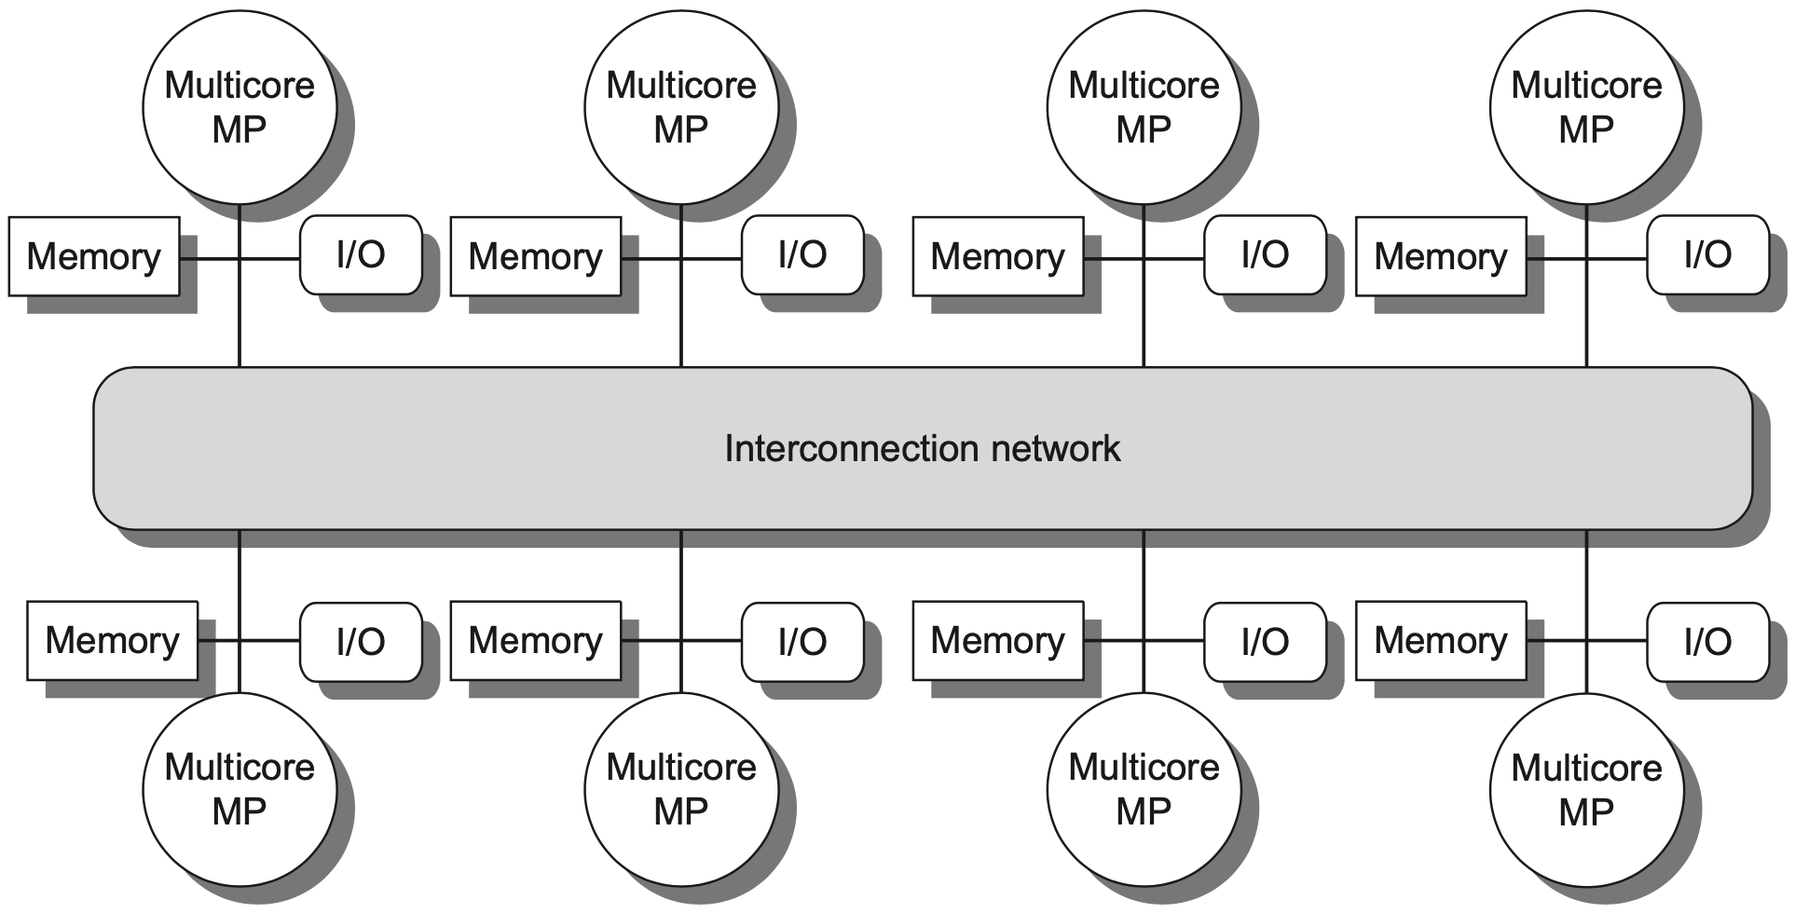
Distributed Shared Memory
more processors
physically distributed memory
Notes:
In contrast, distributed shared memory multiprocessors support more processors and each is attached with a physically distributed memory.
Figure 5.2 The basic architecture of a distributed-memory multiprocessor in 2017 typically consists of a multi- core multiprocessor chip with memory and possibly I/O attached and an interface to an interconnection network that connects all the nodes. Each processor core shares the entire memory, although the access time to the local memory attached to the core’s chip will be much faster than the access time to remote memories.

Slide 15
Distributed Shared Memory
more processors
physically distributed memory
Distributing memory among the nodes
increases bandwidth & reduces local-mem latency
Notes:
Distributing memory among multiple cores increases bandwidth (as more memory accesses can be executed at the same time) and reduces local-memory latency.

Slide 16
Distributed Shared Memory
more processors
physically distributed memory
NUMA: nonuniform memory access
access time depends on data word loc in mem
Notes:
Clearly, access time varies with data location; fetching data from local memory should be faster than fetching data from distant memory.
So distributed shared-memory multiprocessors are also called Nnnuniform memory access multiprocessors

Slide 17
Distributed Shared Memory
more processors
physically distributed memory
Disadvantages:
more complex inter-processor communication
more complex software to handle distributed mem
Notes:
But in comparison with centralized shared memory multiprocessors, distributed version requires more complex designs to handle inter-processor communication and distributed memory.

Slide 18
Hurdles of Parallel Processing
Limited parallelism in programs
Relatively high cost of communications
Notes:
Given these muti-processor architectures, what are the challenges for making the most parallelism out of them?
In particular, limited parallelism within programs and relatively high communication cost of remote access would be the key challenges.

Slide 19
Limited Program Parallelism
Limited parallelism in programs
makes it difficult to achieve good
speedups in any parallel processor
ld
ld
add
add
x1, 0(x0)
x2, 4(x0)
x3, x1, x2
x4, x3, 2
ld
ld
add
add
add
x1, 0(x0)
x2, 4(x0)
x3, x1, 1
x4, x2, 1
x5, x3, x4
compute A+B+2
before
after
Notes:
Limited parallelism within programs will limit the extent of any parallel processor.
Two example code snippets.

Slide 20
Limited Program Parallelism
Limited parallelism in programs
makes it difficult to achieve good
speedups in any parallel processor
ld
ld
add
add
x1, 0(x0)
x2, 4(x0)
x3, x1, x2
x4, x3, 2
IF
ID
IF
EXE
ID
IF
MEM
EXE
ID
IF
WB
MEM
EXE
ID
WB
EXE
EXE
before
Notes:
Limited parallelism within programs will limit the extent of any parallel processor.
Two example code snippets.

Slide 21
Limited Program Parallelism
Limited parallelism in programs
makes it difficult to achieve good speedups in any parallel processor
IF
ID
IF
EXE
ID
IF
MEM
EXE
ID
IF
WB
MEM
EXE
ID
IF
WB
MEM
EXE
ID
WB
MEM
EXE
ld
ld
add
add
add
x1, 0(x0)
x2, 4(x0)
x3, x1, 1
x4, x2, 1
x5, x3, x4
after
Notes:
Limited parallelism within programs will limit the extent of any parallel processor.
Two example code snippets.

Slide 22
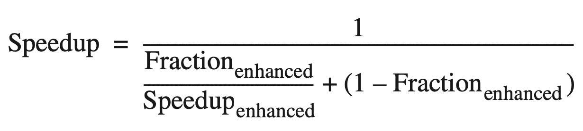
Limited Program Parallelism
Limited parallelism affects speedup
Example 1
to achieve a speedup of 80 with 100 processors, what fraction of the original computation can be sequential?
Answer
by Amdahl’s law

Slide 23
Limited Program Parallelism
Limited parallelism affects speedup
Example 1
to achieve a speedup of 80 with 100 processors, what fraction of the original computation can be sequential?
Answer
assumption: two modes
enhanced mode: 100 processors
serial mode: only 1 processor
Notes:
For simplicity in this example, assume that the program operates in only two modes: parallel with all processors fully used, which is the enhanced mode, or serial with only one processor in use. With this simplification, the speedup in enhanced mode is simply the number of processors, whereas the fraction of enhanced mode is the time spent in parallel mode.

Slide 24
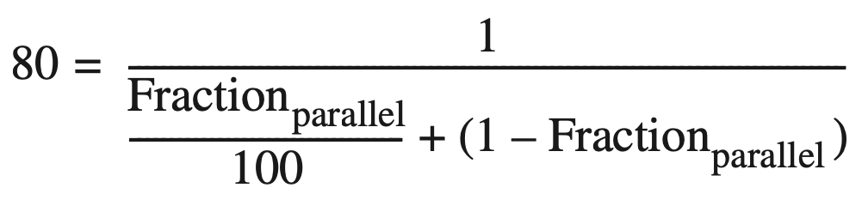
Limited Program Parallelism
Limited parallelism affects speedup
Example 1
to achieve a speedup of 80 with 100 processors, what fraction of the original computation can be sequential?
Answer
by Amdahl’s law

Slide 25
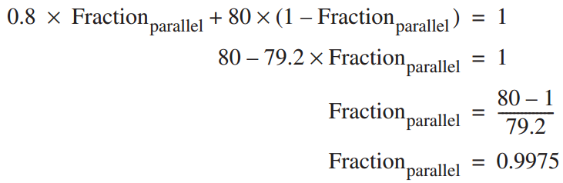
Limited Program Parallelism
Limited parallelism affects speedup
Example 1
to achieve a speedup of 80 with 100 processors, what fraction of the original computation can be sequential?
Answer
by Amdahl’s law
Fraction_{seq} = 1 – Fraction_{parallel}
= 0.25%
Notes:
Thus, to achieve a speedup of 80 with 100 processors, only 0.25% of the original computation can be sequential! Of course, to achieve linear speedup (speedup of n with n processors), the entire program must usually be parallel with no serial portions. In practice, programs do not just operate in fully parallel or sequential mode, but often use less than the full complement of the processors when running in parallel mode. Amdahl’s Law can be used to analyze applications with varying amounts of speedup, as the next example shows.

Slide 26
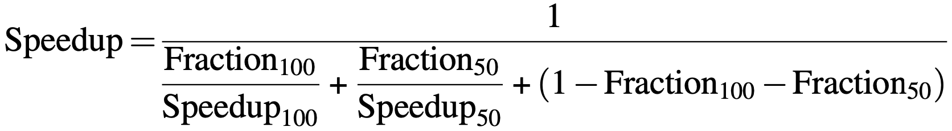
Limited Program Parallelism
Limited parallelism affects speedup
Example 2
app can use 1, 50, or all 100 processors, 95% of the time use all 100 processors, how much of the remaining 5% must employ 50 processors for 80 speedup? Answer by Amdahl’s law

Slide 27
Limited Program Parallelism
Limited parallelism affects speedup
Example 2
app can use 1, 50, or all 100 processors, 95% of the time use all 100 processors, how much of the remaining 5% must employ 50 processors for 80 speedup? Answer by Amdahl’s law: 4.8%

Slide 28
Limited Program Parallelism
Limited parallelism in programs
makes it difficult to achieve good
speedups in any parallel processor;
in practice, programs often use
less than the full complement
of the processors
when running in parallel mode;
Notes:
Based on previous example, an observation

Slide 29
High Communication Cost
Relatively high cost of communications
involves the large latency of remote
access in a parallel processor

Slide 30
High Communication Cost
Relatively high cost of communications
involves the large latency of remote
access in a parallel processor
Example
app running on a 32-processor MP;
100 ns for reference to a remote mem;
clock rate 4.0 GHz; base CPI 0.5;
Q: how much faster if no communication vs if 0.2% remote ref?

Slide 31
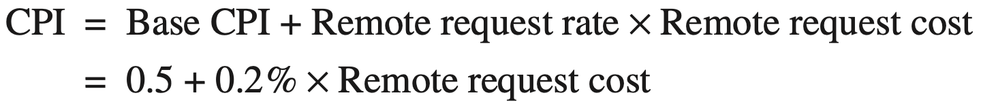
High Communication Cost
Example
app running on a 32-processor MP;
100 ns for reference to a remote mem;
clock rate 4.0 GHz; base CPI 0.5;
Q: how much faster if no communication vs if 0.2% remote ref?
Answer
if 0.2% remote reference

Slide 32
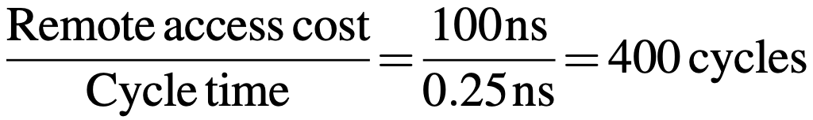
High Communication Cost
Example
app running on a 32-processor MP;
100 ns for reference to a remote mem;
clock rate 4.0 GHz; base CPI 0.5;
Q: how much faster if no communication vs if 0.2% remote ref?
Answer
if 0.2% remote ref, Remote req cost

Slide 33
High Communication Cost
Example
app running on a 32-processor MP;
100 ns for reference to a remote mem;
clock rate 4.0 GHz; base CPI 0.5;
Q: how much faster if no communication vs if 0.2% remote ref?
Answer
if 0.2% remote ref: 0.5+0.2%x400=1.3
no comm is 1.3/0.5 = 2.6 times faster

Slide 34
Improve Parallel Processing
insufficient parallelism
new software algorithms that offer better parallel performance;
software systems that maximize the amount of time spent executing with the full complement of processors;
long-latency remote communication
by architecture: caching shared data…
by programmer: multithreading,
prefetching…

Slide 35
Outline
Multiprocessor Architecture
Centralized Shared Memory
Distributed Shared Memory
Notes:
Now, more details about centralized shared-memory architecture.

Slide 36
Centralized Shared-Memory
Large, multilevel caches
reduce mem bandwidth demands
Notes:
Between processors and the centralized shared main memory, there are large, multilevel caches to reduce memory bandwidth demands.

Slide 37
Centralized Shared-Memory
Cache private/shared data
Notes:
Cached data are either private or shared.

Slide 38
Centralized Shared-Memory
private data
used by a single processor
Notes:
Private data can be used by only a single processor.

Slide 39
Centralized Shared-Memory
shared data
used by multiple processors
may be replicated in multiple caches to reduce
access latency, required mem bw, contention
Notes:
While shared data can be used by multiple processors,
Shared data may be replicated in multiple caches to reduce access latency

Slide 40
Centralized Shared-Memory
w/o additional precautions
different processors can have different values
for the same memory location
shared data
used by multiple processors
may be replicated in multiple caches to reduce
access latency, required mem bw, contention
Notes:
For replicated data across different caches, additional precautions are needed to guarantee their coherence.
Otherwise, different processors may have different values of the same memory location.

Slide 41
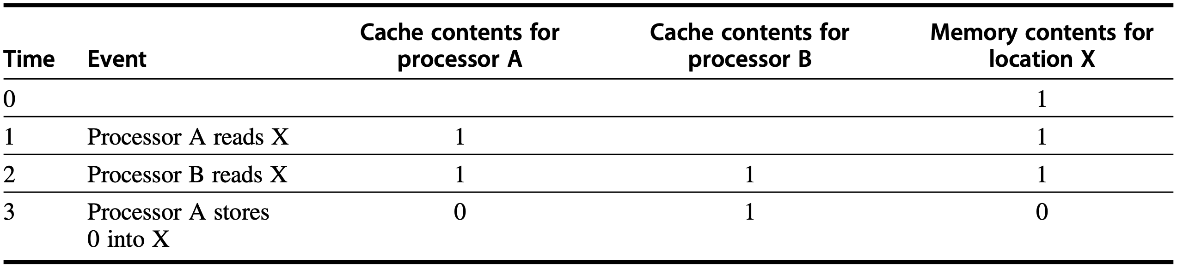
Cache Coherence Problem
without precautions
write-through cache
Notes:
The problem concerning whether the value of shared data is identical in different caches is called cache coherence problem.
Figure5.3 The cache coherence problem for a single memory location(X), read and written by two processors (A and B). We initially assume that neither cache contains the variable and that X has the value 1. We also assume a write- through cache; a write-back cache adds some additional but similar complications. After the value of X has been written by A, A’s cache and the memory both contain the new value, but B’s cache does not, and if B reads the value of X it will receive 1!

Slide 42
Cache Coherence Problem
Global state defined by main memory
Local state defined by the individual caches, private to each processor core
Notes:
The cache coherence problem is interested in two states of cached data.
Global state is defined by main memory;
Local state is defined by individual caches.

Slide 43
Cache Coherence Problem
A memory system is Coherent if any read of a data item returns the most recently written value of that data item
Two critical aspects
coherence: defines what values can be returned by a read
consistency: determines when a written value will be returned by a read
Notes:
Consistency is about ordering of all memory operations from different processors (i.e., to different memory locations).
Global ordering of accesses to all memory locations.
Coherence is about ordering of operations from different processors to the same memory location.
Local ordering of accesses to each cache block.
Cache coherence, memory consistency
https://www.quora.com/What-is-the-difference-between-cache-consistency-and-cache-coherence
Quote from Aamir Ogna, CPU Verification Engineer
“ As far as I know, there's no such thing is "cache" consistency. What you are referring to is probably memory consistency.
Cache coherency is relevant in a multicore system where each processor has a private L1 cache and at least one other level is shared. Memory consistency is relevant whether there are caches or not.
I like the way my professor taught it so I'll give the same example:
Let's say you are the main memory and you have two friends A and B who are two cores in a multicore environment:
A wants to go for a movie on Saturday. So he texts you asking for a good time. You reply back saying 9 PM is a good time. A gets the text, reads it and he is happy. He is also expecting you to co-ordinate the times with B.
A few minutes later, B texts you asking for the time of the movie. You send him the same reply you sent to A, 9 PM. At this point in time, all three of you are agreeing on the same time, that is to say, all of you have the same copy of data.
Something comes up in B's calendar and he needs to reschedule it. So he texts you saying instead of 9, you all will go for the movie at 10 PM. You get the text and your timing is updated. But you fail to pass on this message to A, who still thinks 9 PM is on.
At this point, you (main memory) and B (one of the cores) have the same data, but A (another core) has stale data, since the "write" to the data by B was never propagated to A. A will still show up at 9 PM for the movie, won't find either of you, get pissed off and watch the movie all alone, live texting you the entire story spoiling everything for you!
This is what cache coherency is all about. It's about making sure that every private copy is the same everywhere and if any changes are made, those changes are propagated to every private cache.
We can use the same example to understand memory consistency as well, but in this case, you are also a core:
A wants to go for the movie on Saturday at 9 PM. So he sends out a text_1 saying "Movie at 9" to both, you and B. A few minutes later, his plan changes and now he wants to watch it at 10 PM instead. So he sends out another text_2 saying "Movie at 10". So both, you and B are informed of the time changes, but something funky happens.
B's telephone network is crappy and he receives the text_2 BEFORE text_1. B is thinking the initial plan was 10 PM that got moved to 9 while you are thinking it was 9 PM that got moved to 10. In this case, both of you got updated copies, but at different times in a different order. Either ways, someone is going to get pissed and spoil the movie for the others.
This is memory consistency. It's not enough that a core sees the write happening to shared data, it's also important that they see the writes in the same order as other cores. Otherwise, data will be inconsistent across cores.
Hope this helps.
”

Slide 44
Coherence Property: 1/3
A memory is coherent if: 3-1
A read by processor P to location X that follows a write by P to X, with no writes of X by another processor occurring between the write and the read by P,
always returns the value written by P.
write -> read: returns written value
preserves program order
Notes:
The first property simply preserves program order—we expect this property to
be true even in uniprocessors.

Slide 45
Coherence Property: 2/3
A memory is coherent if: 3-2
A read by a processor to location X that follows a write by another processor to X returns the written value if the read and the write are sufficiently separated in time and no other writes to X occur between the two accesses.
write -> read: returns written value
Notes:
The second property defines the notion of what it means to have a coherent view of memory: if a processor could continuously read an old data value, we would clearly say that memory was incoherent.

Slide 46
Coherence Property: 3/3
A memory is coherent if: 3-3
Write serialization
two writes to the same location by any two processors are seen in the same order by all processors
Notes:
Writes to the same location are serialized; that is, two writes to the same location by any two processors are seen in the same order by all processors. For example, if the values 1 and then 2 are written to a location, processors can never read the value of the location as 2 and then later read it as 1.
Sup- pose we did not serialize writes, and processor P1 writes location X followed by P2 writing location X. Serializing the writes ensures that every processor will see the write done by P2 at some point. If we did not serialize the writes, it might be the case that some processors could see the write of P2 first and then see the write of P1, maintaining the value written by P1 indefinitely. The simplest way to avoid such difficulties is to ensure that all writes to the same location are seen in the same order; this property is called write serialization.

Slide 47
Consistency
When a written value will be seen is important
Memory consistency protocol
Notes:
Although the three properties just described are sufficient to ensure coherence, the question of when a written value will be seen is also important. To see why, observe that we cannot require that a read of X instantaneously see the value written for X by some other processor. If, for example, a write of X on one processor precedes a read of X on another processor by a very small time, it may be impossible to ensure that the read returns the value of the data written, since the written data may not even have left the processor at that point. The issue of exactly when a written value must be seen by a reader is defined by a memory consistency model—a topic discussed in Section 5.6.

Slide 48
Consistency
Example: a write of X on one processor precedes a read of X on another processor by a very small time, it may be impossible to ensure that the read returns the value of the data written,
since the written data may not even have left the processor at that point

Slide 49
how to enforce coherence?

Slide 50
Cache Coherence Protocols
Directory based
the sharing status of a particular block of physical memory is kept in one location, called directory
Snooping
every cache that has a copy of the data from a block of physical memory could track the sharing status of the block
Snooping
Notes:
The protocols to maintain coherence for multiple processors are called cache coherence protocols. Key to implementing a cache coherence protocol is tracking the state of any sharing of a data block. The state of any cache block is kept using status bits associated with the block, similar to the valid and dirty bits kept in a uniprocessor cache. There are two classes of protocols in use, each of which uses different techniques to track the sharing status:
Directory based—The sharing status of a particular block of physical memory is kept in one location, called the directory. There are two very different types of directory-based cache coherence. In an SMP, we can use one centralized directory, associated with the memory or some other single serialization point, such as the outermost cache in a multicore. In a DSM, it makes no sense to have a single directory because that would create a single point of contention and make it difficult to scale to many multicore chips given the memory demands of multicores with eight or more cores. Distributed directories are more com- plex than a single directory, and such designs are the subject of Section 5.4.
Snooping—Rather than keeping the state of sharing in a single directory, every cache that has a copy of the data from a block of physical memory could track the sharing status of the block. In an SMP, the caches are typically all acces- sible via some broadcast medium (e.g., a bus connects the per-core caches to the shared cache or memory), and all cache controllers monitor or snoop on the medium to determine whether they have a copy of a block that is requested on a bus or switch access. Snooping can also be used as the coherence protocol for a multichip multiprocessor, and some designs support a snooping protocol on top of a directory protocol within each multicore.

Slide 51
Snooping Coherence Protocol
Snooping
Write invalidate protocol
invalidate other copies on a write
exclusive access ensures that no other readable or writable copies of an item exist when the write occurs
Notes:
One method is to ensure that a processor has exclusive access to a data item before writing that item. This style of protocol is called a write invalidate protocol because it invalidates other copies on a write. It is by far the most common pro- tocol. Exclusive access ensures that no other readable or writable copies of an item exist when the write occurs: all other cached copies of the item are invalidated.

Slide 52
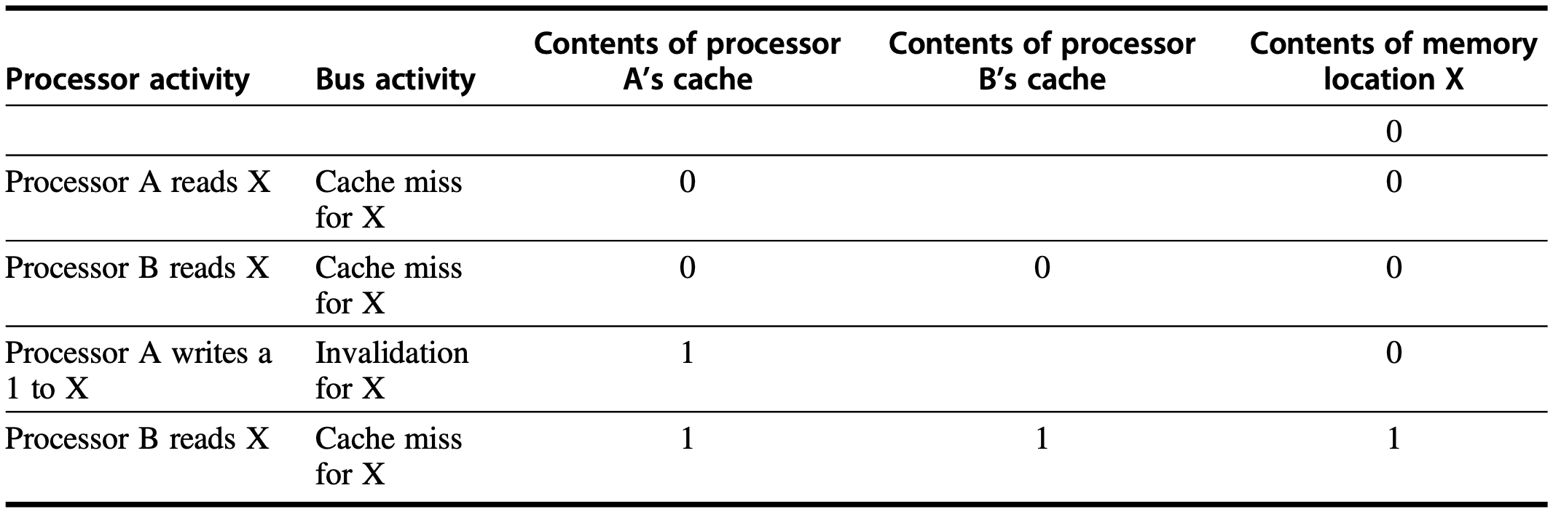
Snooping Coherence Protocol
Write invalidate protocol
invalidate other copies on a write
write-back cache
update memory when a block becomes shared simplifies the protocol
Notes:
P209 on 4th edition: update of memory occurs when a block becomes shared simplifies the protocol
Figure 5.4 An example of an invalidation protocol working on a snooping bus for a single cache block (X) with write-back caches. We assume that neither cache initially holds X and that the value of X in memory is 0. The processor and memory contents show the value after the processor and bus activity have both completed. A blank indi- cates no activity or no copy cached. When the second miss by B occurs, processor A responds with the value canceling the response from memory. In addition, both the contents of B’s cache and the memory contents of X are updated. This update of memory, which occurs when a block becomes shared, simplifies the protocol, but it is possible to track the ownership and force the write-back only if the block is replaced. This requires the introduction of an additional status bit indicating ownership of a block. The ownership bit indicates that a block may be shared for reads, but only the owning processor can write the block, and that processor is responsible for updating any other processors and memory when it changes the block or replaces it. If a multicore uses a shared cache (e.g., L3), then all memory is seen through the shared cache; L3 acts like the memory in this example, and coherency must be handled for the private L1 and L2 caches for each core. It is this observation that led some designers to opt for a directory protocol within the multicore. To make this work, the L3 cache must be inclusive; recall from Chapter 2, that a cache is inclusive if any location in a higher level cache (L1 and L2 in this case) is also in L3. We return to the topic of inclusion on page 423.

Slide 53
Snooping Coherence Protocol
Write invalidate protocol
invalidate other copies on a write
write-back cache
shared-state block loses tracking of block ownership
Notes:
P209 on 4th edition: update of memory occurs when a block becomes shared simplifies the protocol
Figure 5.4 An example of an invalidation protocol working on a snooping bus for a single cache block (X) with write-back caches. We assume that neither cache initially holds X and that the value of X in memory is 0. The processor and memory contents show the value after the processor and bus activity have both completed. A blank indi- cates no activity or no copy cached. When the second miss by B occurs, processor A responds with the value canceling the response from memory. In addition, both the contents of B’s cache and the memory contents of X are updated. This update of memory, which occurs when a block becomes shared, simplifies the protocol, but it is possible to track the ownership and force the write-back only if the block is replaced. This requires the introduction of an additional status bit indicating ownership of a block. The ownership bit indicates that a block may be shared for reads, but only the owning processor can write the block, and that processor is responsible for updating any other processors and memory when it changes the block or replaces it. If a multicore uses a shared cache (e.g., L3), then all memory is seen through the shared cache; L3 acts like the memory in this example, and coherency must be handled for the private L1 and L2 caches for each core. It is this observation that led some designers to opt for a directory protocol within the multicore. To make this work, the L3 cache must be inclusive; recall from Chapter 2, that a cache is inclusive if any location in a higher level cache (L1 and L2 in this case) is also in L3. We return to the topic of inclusion on page 423.

Slide 54
Snooping Coherence Protocol
Write invalidate protocol
invalidate other copies on a write
write-back cache
hard to regulate which core to write-back upon eviction
Notes:
P209 on 4th edition: update of memory occurs when a block becomes shared simplifies the protocol
Figure 5.4 An example of an invalidation protocol working on a snooping bus for a single cache block (X) with write-back caches. We assume that neither cache initially holds X and that the value of X in memory is 0. The processor and memory contents show the value after the processor and bus activity have both completed. A blank indi- cates no activity or no copy cached. When the second miss by B occurs, processor A responds with the value canceling the response from memory. In addition, both the contents of B’s cache and the memory contents of X are updated. This update of memory, which occurs when a block becomes shared, simplifies the protocol, but it is possible to track the ownership and force the write-back only if the block is replaced. This requires the introduction of an additional status bit indicating ownership of a block. The ownership bit indicates that a block may be shared for reads, but only the owning processor can write the block, and that processor is responsible for updating any other processors and memory when it changes the block or replaces it. If a multicore uses a shared cache (e.g., L3), then all memory is seen through the shared cache; L3 acts like the memory in this example, and coherency must be handled for the private L1 and L2 caches for each core. It is this observation that led some designers to opt for a directory protocol within the multicore. To make this work, the L3 cache must be inclusive; recall from Chapter 2, that a cache is inclusive if any location in a higher level cache (L1 and L2 in this case) is also in L3. We return to the topic of inclusion on page 423.

Slide 55
Snooping Coherence Protocol
Write invalidate protocol
invalidate other copies on a write
write-back cache
update of memory ensures that memory already holds the latest value
Notes:
P209 on 4th edition: update of memory occurs when a block becomes shared simplifies the protocol
Figure 5.4 An example of an invalidation protocol working on a snooping bus for a single cache block (X) with write-back caches. We assume that neither cache initially holds X and that the value of X in memory is 0. The processor and memory contents show the value after the processor and bus activity have both completed. A blank indi- cates no activity or no copy cached. When the second miss by B occurs, processor A responds with the value canceling the response from memory. In addition, both the contents of B’s cache and the memory contents of X are updated. This update of memory, which occurs when a block becomes shared, simplifies the protocol, but it is possible to track the ownership and force the write-back only if the block is replaced. This requires the introduction of an additional status bit indicating ownership of a block. The ownership bit indicates that a block may be shared for reads, but only the owning processor can write the block, and that processor is responsible for updating any other processors and memory when it changes the block or replaces it. If a multicore uses a shared cache (e.g., L3), then all memory is seen through the shared cache; L3 acts like the memory in this example, and coherency must be handled for the private L1 and L2 caches for each core. It is this observation that led some designers to opt for a directory protocol within the multicore. To make this work, the L3 cache must be inclusive; recall from Chapter 2, that a cache is inclusive if any location in a higher level cache (L1 and L2 in this case) is also in L3. We return to the topic of inclusion on page 423.
::MOESI adds the state Owned to the MESI protocol to indicate that the associ- ated block is owned by that cache and out-of-date in memory. In MSI and MESI protocols, when there is an attempt to share a block in the Modified state, the state is changed to Shared (in both the original and newly sharing cache), and the block must be written back to memory. In a MOESI protocol, the block can be changed from the Modified to Owned state in the original cache without writing it to memory. Other caches, which are newly sharing the block, keep the block in the Shared state; the O state, which only the original cache holds, indicates that the main memory copy is out of date and that the designated cache is the owner. The owner of the block must supply it on a miss, since memory is not up to date and must write the block back to memory if it is replaced. The AMD Opteron processor family uses the MOESI protocol.

Slide 56
Snooping Coherence Protocol
Write update/broadcast protocol
update all cached copies of a data item when that item is written
consume more bandwidth

Slide 57
Write Invalidate Protocol
To perform an invalidate, the processor simply acquires bus access and broadcasts the address to be invalidated on the bus

Slide 58
Write Invalidate Protocol
To perform an invalidate, the processor simply acquires bus access and broadcasts the address to be invalidated on the bus
All processors continuously snoop on the bus, watching the addresses

Slide 59
Write Invalidate Protocol
To perform an invalidate, the processor simply acquires bus access and broadcasts the address to be invalidated on the bus
All processors continuously snoop on the bus, watching the addresses
The processors check whether the address on the bus is in their cache;
if so, the corresponding data block in the cache is invalidated.

Slide 60
Write Invalidate Protocol
To perform an invalidate, the processor simply acquires bus access and broadcasts the address to be invalidated on the bus
All processors continuously snoop on the bus, watching the addresses
If a processor finds that it has a dirty copy of a requested cache block,
it provides that cache block and causes memory/L3 access to be aborted.

Slide 61
Write Invalidate Protocol
how to implement?

Slide 62
Write Invalidate Protocol
Incoporate a finite-state controller in each core
Repspond to requests from the processor in the core and from the bus (or other broadcast medium)
Change the state of the selected cache block
Use the bus to access data or to invalidate it
Notes:
A snooping coherence protocol is usually implemented by incorporating a finite- state controller in each core. This controller responds to requests from the processor in the core and from the bus (or other broadcast medium), changing the state of the selected cache block, as well as using the bus to access data or to invalidate it.
Logically, you can think of a separate controller as being associated with each block; that is, snooping operations or cache requests for different blocks can proceed independently.

Slide 63
Write Invalidate Protocol
MSI protocol: three block states
Invalid
Shared
indicates that the block in the private cache is potentially shared
Modified
indicates that the block has been updated in the private cache;
implies that the block is exclusive
Notes:
The simple protocol we consider has three states: invalid, shared, and mod- ified. The shared state indicates that the block in the private cache is potentially shared, while the modified state indicates that the block has been updated in the private cache; note that the modified state implies that the block is exclusive.

Slide 64
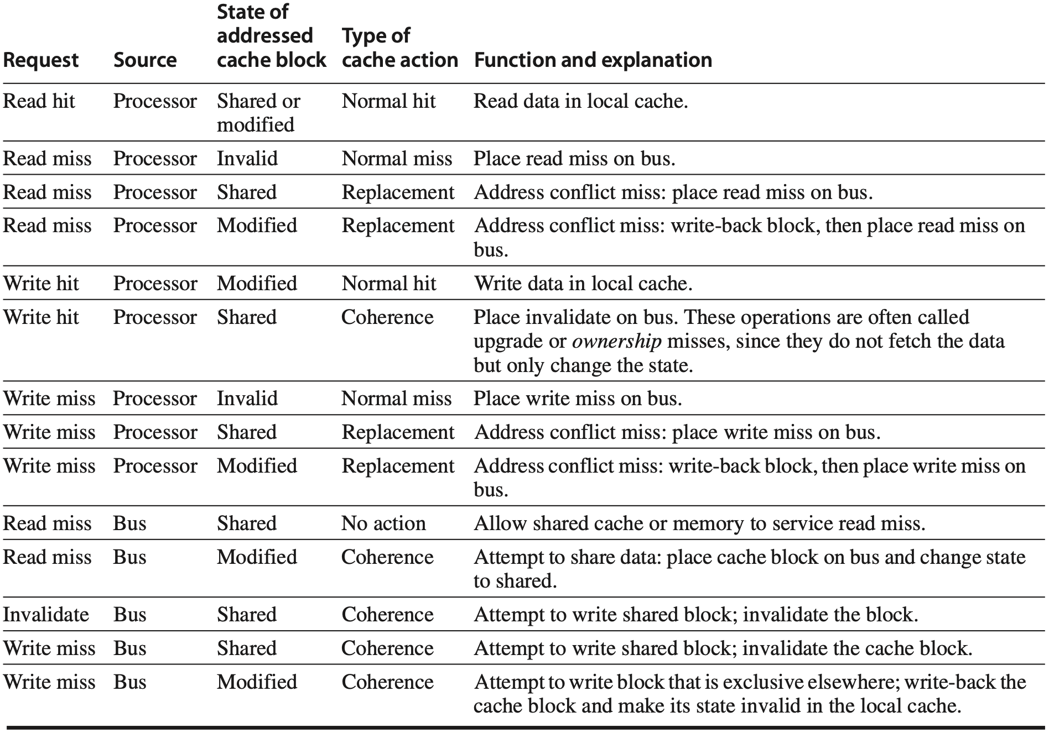
Write Invalidate Protocol
write-back block
Notes:
Figure 5.5 shows the requests generated by a core (in the top half of the table)
as well as those coming from the bus (in the bottom half of the table).
This protocol is for a write-back cache but is easily changed to work for a write-through cache by reinterpreting the modified state as an exclusive state and updating the cache on writes in the normal fashion for a write-through cache. The most common extension of this basic protocol is the addition of an exclusive state, which describes a block that is unmodified but held in only one private cache.
Figure 5.5 The cache coherence mechanism receives requests from both the core’s processor and the shared bus and responds to these based on the type of request, whether it hits or misses in the local cache, and the state of the local cache block specified in the request. The fourth column describes the type of cache action as normal hit or miss (the same as a uniprocessor cache would see), replacement (a uniprocessor cache replacement miss), or coherence (required to maintain cache coherence); a normal or replacement action may cause a coherence action depending on the state of the block in other caches. For read, misses, write misses, or invalidates snooped from the bus, an action is required only if the read or write addresses match a block in the local cache and the block is valid.

Slide 65
Write Invalidate Protocol
replacement
write-back cache
write-back block
Notes:
Figure 5.5 shows the requests generated by a core (in the top half of the table)
as well as those coming from the bus (in the bottom half of the table).
This protocol is for a write-back cache but is easily changed to work for a write-through cache by reinterpreting the modified state as an exclusive state and updating the cache on writes in the normal fashion for a write-through cache. The most common extension of this basic protocol is the addition of an exclusive state, which describes a block that is unmodified but held in only one private cache.
Figure 5.5 The cache coherence mechanism receives requests from both the core’s processor and the shared bus and responds to these based on the type of request, whether it hits or misses in the local cache, and the state of the local cache block specified in the request. The fourth column describes the type of cache action as normal hit or miss (the same as a uniprocessor cache would see), replacement (a uniprocessor cache replacement miss), or coherence (required to maintain cache coherence); a normal or replacement action may cause a coherence action depending on the state of the block in other caches. For read, misses, write misses, or invalidates snooped from the bus, an action is required only if the read or write addresses match a block in the local cache and the block is valid.
**write miss from bus, modified, coherence, Attempt to write block that is exclusive elsewhere --- indicates the attempt from the core that issues the write miss request, the exclusive state corresponds to the core that holds the Modified data

Slide 66
Write Invalidate Protocol
figure 5.4
update memory to simplify protocol
write-back block
Notes:
Figure 5.5 shows the requests generated by a core (in the top half of the table)
as well as those coming from the bus (in the bottom half of the table).
This protocol is for a write-back cache but is easily changed to work for a write-through cache by reinterpreting the modified state as an exclusive state and updating the cache on writes in the normal fashion for a write-through cache. The most common extension of this basic protocol is the addition of an exclusive state, which describes a block that is unmodified but held in only one private cache.
Figure 5.5 The cache coherence mechanism receives requests from both the core’s processor and the shared bus and responds to these based on the type of request, whether it hits or misses in the local cache, and the state of the local cache block specified in the request. The fourth column describes the type of cache action as normal hit or miss (the same as a uniprocessor cache would see), replacement (a uniprocessor cache replacement miss), or coherence (required to maintain cache coherence); a normal or replacement action may cause a coherence action depending on the state of the block in other caches. For read, misses, write misses, or invalidates snooped from the bus, an action is required only if the read or write addresses match a block in the local cache and the block is valid.
**write miss from bus, modified, coherence, Attempt to write block that is exclusive elsewhere --- indicates the attempt from the core that issues the write miss request, the exclusive state corresponds to the core that holds the Modified data

Slide 67
Write Invalidate Protocol
figure 5.6
need also place cache block on bus
to service write miss
write-back block
Notes:
Figure 5.5 shows the requests generated by a core (in the top half of the table)
as well as those coming from the bus (in the bottom half of the table).
This protocol is for a write-back cache but is easily changed to work for a write-through cache by reinterpreting the modified state as an exclusive state and updating the cache on writes in the normal fashion for a write-through cache. The most common extension of this basic protocol is the addition of an exclusive state, which describes a block that is unmodified but held in only one private cache.
Figure 5.5 The cache coherence mechanism receives requests from both the core’s processor and the shared bus and responds to these based on the type of request, whether it hits or misses in the local cache, and the state of the local cache block specified in the request. The fourth column describes the type of cache action as normal hit or miss (the same as a uniprocessor cache would see), replacement (a uniprocessor cache replacement miss), or coherence (required to maintain cache coherence); a normal or replacement action may cause a coherence action depending on the state of the block in other caches. For read, misses, write misses, or invalidates snooped from the bus, an action is required only if the read or write addresses match a block in the local cache and the block is valid.
**write miss from bus, modified, coherence, Attempt to write block that is exclusive elsewhere --- indicates the attempt from the core that issues the write miss request, the exclusive state corresponds to the core that holds the Modified data

Slide 68
Write Invalidate Protocol
how do states transit?

Slide 69
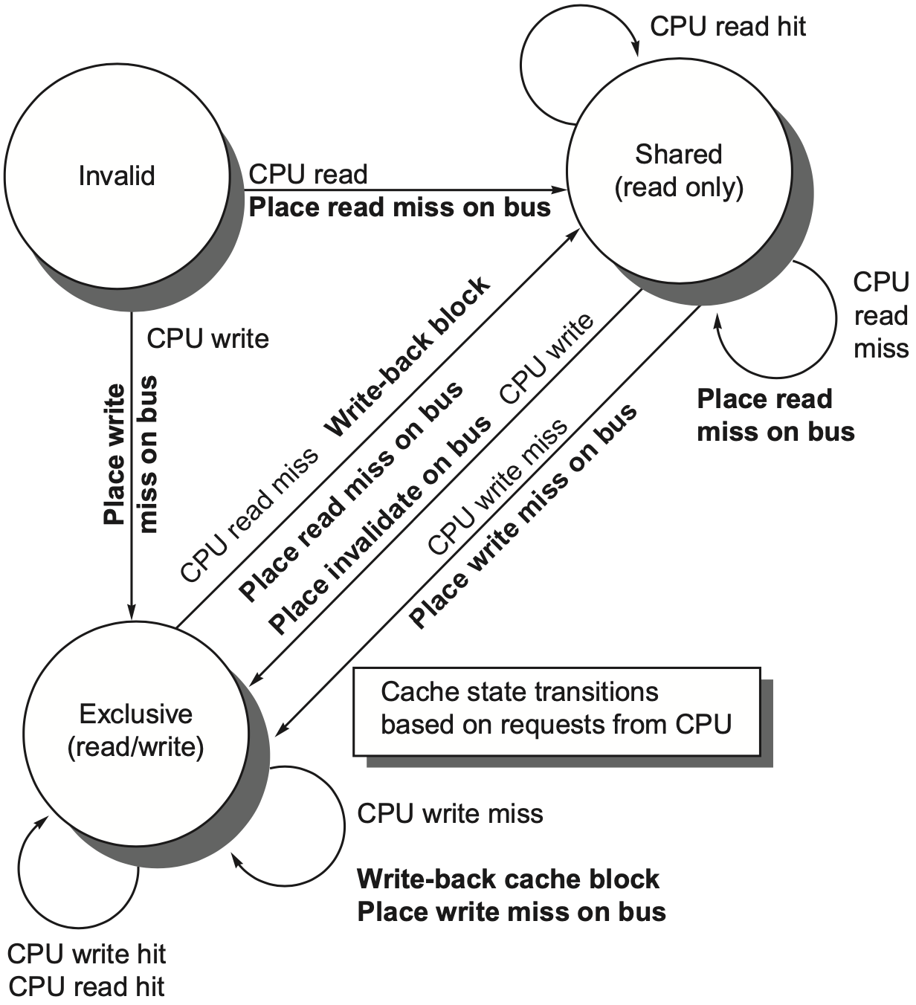
Write Invalidate Protocol
write-back cache
processor requests on arcs
bus actions in bold
https://www.youtube.com/watch?v=gAUVAel-2Fg
State Transition: Refer to the previous table
Notes:
Figure 5.6 A write invalidate, cache coherence protocol for a private write-back cache showing the states and state transitions for each block in the cache. The cache states are shown in circles, with any access permitted by the local processor without a state transition shown in parentheses under the name of the state. The stimulus causing a state change is shown on the transition arcs in regular type, and any bus actions generated as part of the state transition are shown on the transition arc in bold. The stimulus actions apply to a block in the private cache, not to a specific address in the cache. Thus a read miss to a block in the shared state is a miss for that cache block but for a different address. The left side of the diagram shows state transitions based on actions of the processor asso- ciated with this cache; the right side shows transitions based on operations on the bus. A read miss in the exclusive or shared state and a write miss in the exclusive state occur when the address requested by the processor does not match the address in the local cache block. Such a miss is a standard cache replacement miss. An attempt to write a block in the shared state generates an invalidate. Whenever a bus transaction occurs, all private caches that contain the cache block specified in the bus transaction take the action dictated by the right half of the diagram. The protocol assumes that memory (or a shared cache) provides data on a read miss for a block that is clean in all local caches. In actual implementations, these two sets of state diagrams are combined. In practice, there are many subtle variations on invalidate protocols, including the introduction of the exclusive unmodified state, as to whether a processor or memory provides data on a miss. In a multicore chip, the shared cache (usually L3, but sometimes L2) acts as the equivalent of memory, and the bus is the bus between the private caches of each core and the shared cache, which in turn interfaces to the memory.

Slide 70
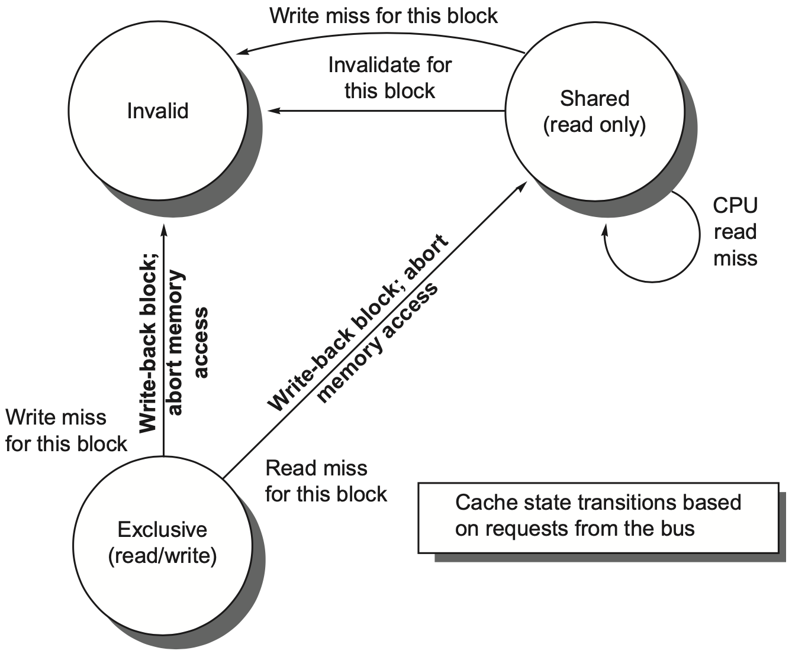
Write Invalidate Protocol
write-back cache
bus requests on arcs
bus actions in bold
Notes:
Whenever a bus transaction occurs, all private caches that contain the cache block specified in the bus transaction take the action dictated by the right half of the diagram. The proto- col assumes that memory (or a shared cache) provides data on a read miss for a block that is clean in all local caches. In actual implementations, these two sets of state diagrams are combined. In practice, there are many subtle varia- tions on invalidate protocols, including the introduction of the exclusive unmodified state, as to whether a processor or memory provides data on a miss. In a multicore chip, the shared cache (usually L3, but sometimes L2) acts as the equivalent of memory, and the bus is the bus between the private caches of each core and the shared cache, which in turn interfaces to the memory.

Slide 71
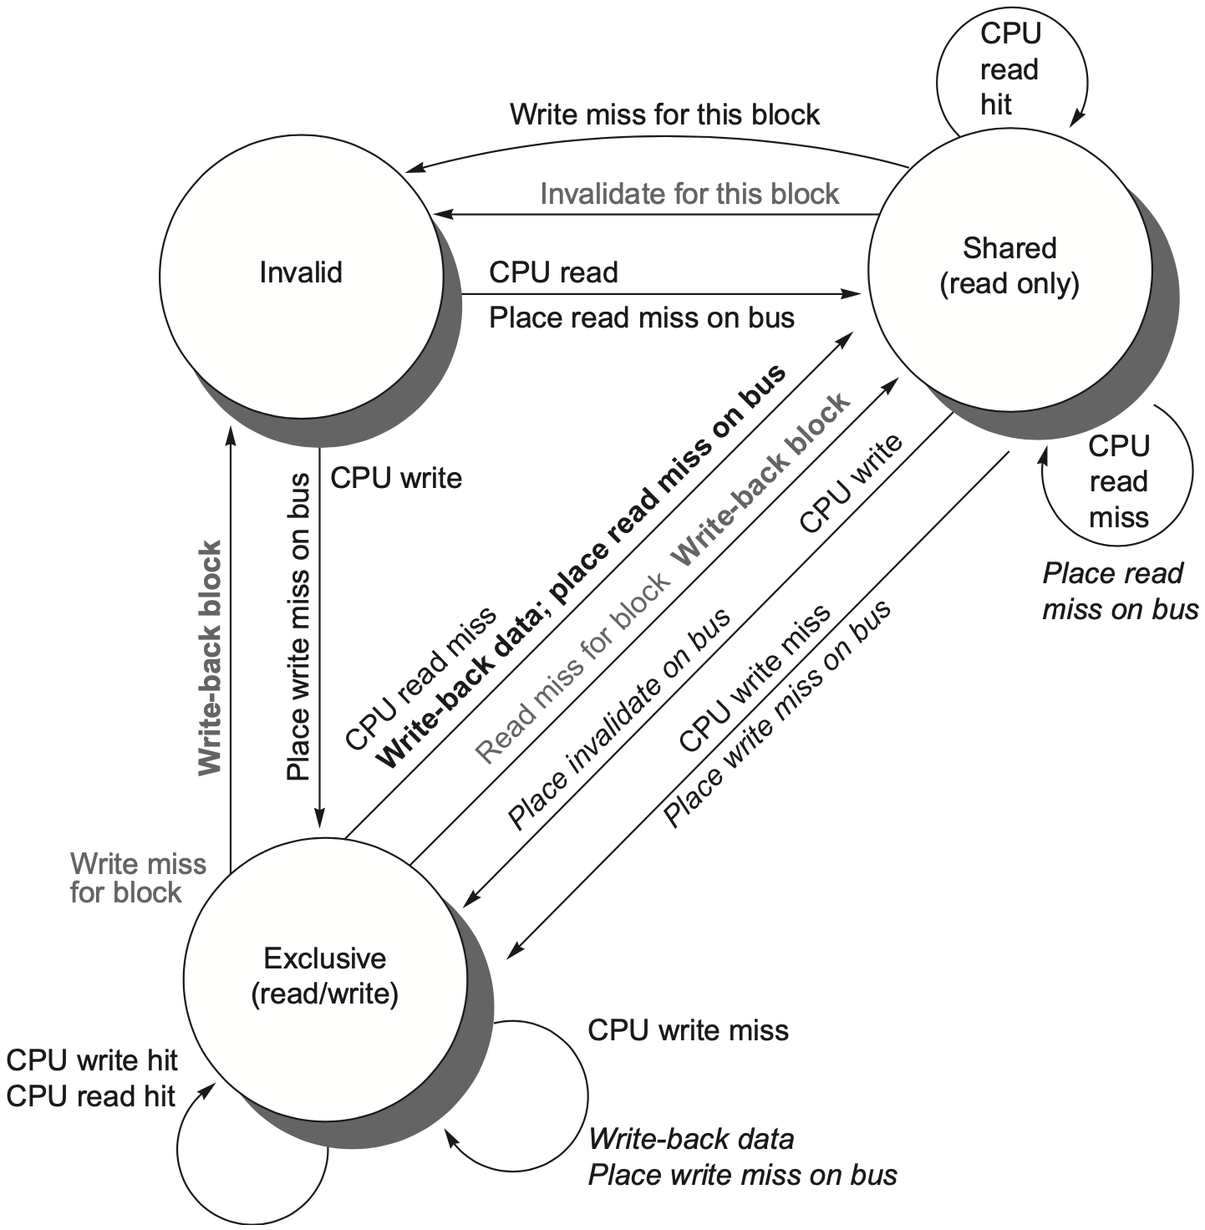
Write Invalidate Protocol
write-back cache
by local processor
by bus activities
https://www.youtube.com/watch?v=gAUVAel-2Fg
State Transition: Refer to the previous table
Notes:
Figure 5.7 Cache coherence state diagram with the state transitions induced by the local processor shown in black and by the bus activities shown in gray. As in Figure 5.6, the activities on a transition are shown in bold.

Slide 72
MSI Extensions: MESI
MESI
exclusive: indicates when a cache block is resident only in a single cache but is clean
exclusive->read by others->shared;
exclusive->write->modified
Notes:
refer to https://www.youtube.com/watch?v=OLGEtXV4U3I
MESI writes exclusive to modified silently, without broadcast on bus

Slide 73
MSI Extensions: MESI
MESI
exclusive: indicates when a cache block is resident only in a single cache but is clean
exclusive->read by others->shared;
exclusive->write->modified (without generating any invalidates)
writing an E-block need not invalidate on bus
Notes:
refer to https://www.youtube.com/watch?v=OLGEtXV4U3I
MESI writes exclusive to modified silently, without broadcast on bus
MESI adds the state Exclusive to the basic MSI protocol to indicate when a cache block is resident only in a single cache but is clean. If a block is in the E state, it can be written without generating any invalidates, which optimizes the case where a block is read by a single cache before being written by that same cache. Of course, when a read miss to a block in the E state occurs, the block must be changed to the S state to maintain coherence. Because all sub- sequent accesses are snooped, it is possible to maintain the accuracy of this state. In particular, if another processor issues a read miss, the state is changed from exclusive to shared. The advantage of adding this state is that a subsequent write to a block in the exclusive state by the same core need not acquire bus access or generate an invalidate, since the block is known to be exclusively in this local cache; the processor merely changes the state to modified. This state is easily added by using the bit that encodes the coherent state as an exclusive state and using the dirty bit to indicate that a bock is modified. The popular MESI protocol, which is named for the four states it includes (Modified, Exclusive, Shared, and Invalid), uses this structure.
The Intel i7 uses a variant of a MESI protocol, called MESIF, which adds a state (Forward) to designate which sharing processor should respond to a request. It is designed to enhance performance in distributed memory organizations.

Slide 74
MSI Extensions: MOESI
MOESI
owned: indicates that the associated block is owned by that cache and out-of-date in memory
modified -> owned upon a read miss on bus
Notes:
MOESI adds the state Owned to the MESI protocol to indicate that the associated block is owned by that cache and out-of-date in memory. In MSI and MESI protocols, when there is an attempt to share a block in the Modified state, the state is changed to Shared (in both the original and newly sharing cache), and the block must be written back to memory. In a MOESI protocol, the block can be changed from the Modified to Owned state in the original cache without writing it to memory. Other caches, which are newly sharing the block, keep the block in the Shared state; the O state, which only the original cache holds, indicates that the main memory copy is out of date and that the designated cache is the owner. The owner of the block must supply it on a miss, since memory is not up to date and must write the block back to memory if it is replaced. The AMD Opteron uses the MOESI protocol.

Slide 75
MSI Extensions: MOESI
MOESI
owned: indicates that the associated block is owned by that cache and out-of-date in memory
modified -> owned upon a read miss on bus
without writing the shared block to memory

Slide 76
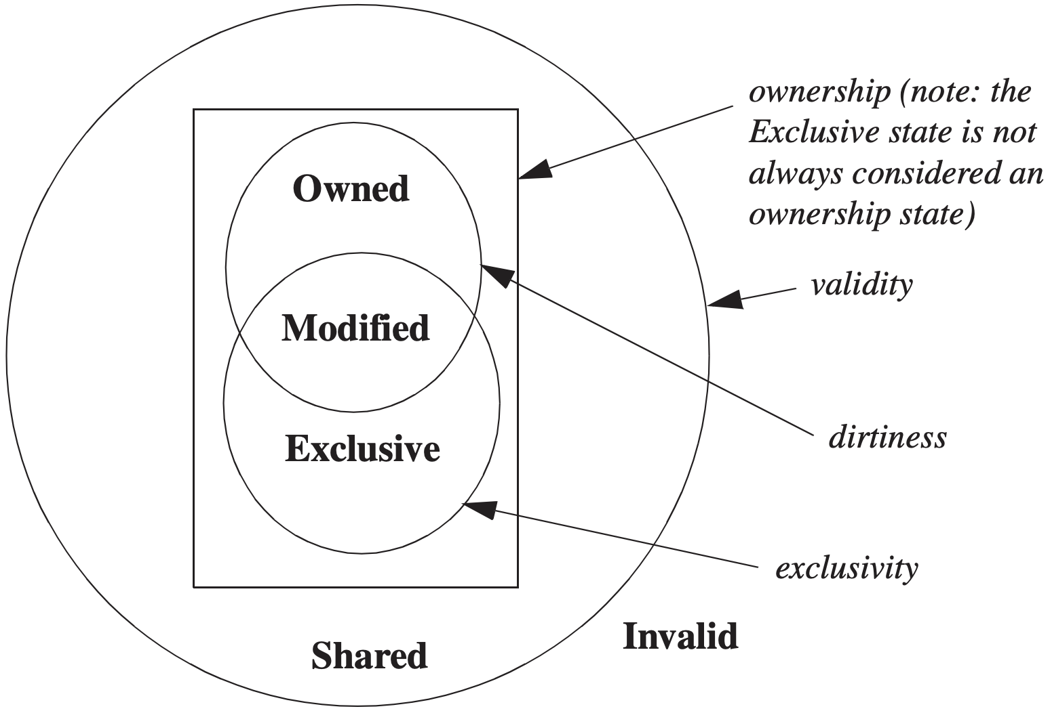
MSI Extensions: MOESI
Notes:
The Venn diagram shows which states share which characteristics. All states besides I are valid. M, O, and E are ownership states. Both M and E denote exclusivity, in that no other caches have a valid copy of the block. Both M and O indicate that the block is potentially dirty.

Slide 77
Centralized Shared-Memory

Slide 78
Write Invalidate Protocol
how to de-bottleneck?

Slide 79
Increase Snoop Bandwidth
Duplicate tags to reduce interference with processor cache accesses
Distribute outermost shared cache (L3) each processor has a portion of the memory and handles snoops for only that portion of the address space
Place a directory at outermost shared cache (L3) as a filter on snoop requests that do not associate with cached data
Notes:
1. Every bus transaction must check the cache-address tags, which could poten- tially interfere with processor cache accesses. One way to reduce this interference is to duplicate the tags and have snoop accesses directed to the duplicate tags. Another approach is to use a directory at the shared L3 cache; the directory indicates whether a given block is shared and possibly which cores have copies. With the directory information, invalidates can be directed only to those caches with copies of the cache block. This requires that L3 must always have a copy of any data item in L1 or L2, a property called inclusion, which we will return to in Section 5.7.
As mentioned earlier, the tags can be duplicated. This doubles the effective cache-level snoop bandwidth. If we assume that half the coherence requests do not hit on a snoop request and the cost of the snoop request is only 10 cycles (versus 15), then we can cut the average cost of a CMR to 12.5 cycles. This reduction allows the coherence miss rate to be 0.88, or alternatively to support one additional processor (7 versus 6).
2. If the outer most cache on a multicore (typically L3) is shared, we can distribute that cache so that each processor has a portion of the memory and handles snoops for that portion of the address space. This approach, used by the IBM 12-core Power8, leads to a NUCA design, but effectively scales the snoop bandwidth at L3 by the number of processors. If there is a snoop hit in L3, then we must still broadcast to all L2 caches, which must in turn snoop their contents. Since L3 is acting as a filter on the snoop requests, L3 must be inclusive.
3. We can place a directory at the level of the outermost shared cache (say, L3). L3 acts as a filter on snoop requests and must be inclusive. The use of a directory at L3 means that we need not snoop or broadcast to all the L2 caches, but only those that the directory indicates may have a copy of the block. Just as L3 may be distributed, the associated directory entries may also be distributed. This approach is used in the Intel Xeon E7 series, which supports from 8 to 32 cores.

Slide 80
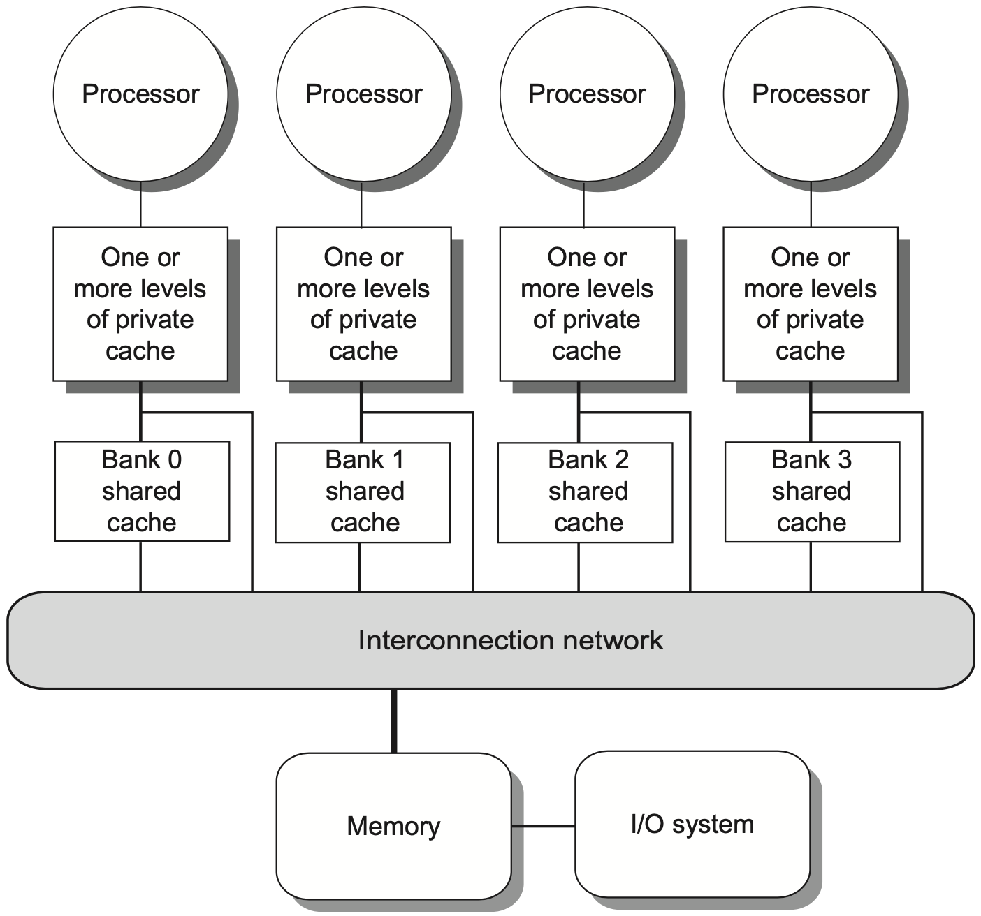
Increase Snoop Bandwidth
increase mem bandwidth
through multi-bus + interconnection network
and multi-bank cache
Notes:
Still shared memory
Then about its performance
Figure 5.8 A single-chip multicore with a distributed cache. In current designs, the distributed shared cache is usually L3, and levels L1 and L2 are private. There are typ- ically multiple memory channels (2–8 in today’s designs). This design is NUCA, since the access time to L3 portions varies with faster access time for the directly attached core. Because it is NUCA, it is also NUMA.

Slide 81
Coherence Miss
True sharing miss
case 1: first write by a processor to a shared cache block causes an invalidation to establish ownership of that block;
case 2: another processor reads a modified word in that cache block;
False sharing miss
Notes:
the misses that arise from interprocessor communication, which are often called coherence misses, can be broken into two separate sources.
The first source is the true sharing misses that arise from the communication of data through the cache coherence mechanism. In an invalidation-based protocol, the first write by a processor to a shared cache block causes an invalidation to establish ownership of that block. Additionally, when another processor attempts to read a modified word in that cache block, a miss occurs and the resultant block is transferred. Both these misses are classified as true sharing misses because they directly arise from the sharing of data among processors.

Slide 82
Coherence Miss
True sharing miss
False sharing miss
a single valid bit per cache block;
occurs when a block is invalidated (and a subsequent reference causes a miss) because some word in the block, other than the one being read, is written into
Notes:
The second effect, called false sharing, arises from the use of an invalidation- based coherence algorithm with a single valid bit per cache block. False sharing occurs when a block is invalidated (and a subsequent reference causes a miss) because some word in the block, other than the one being read, is written into. If the word written into is actually used by the processor that received the inval- idate, then the reference was a true sharing reference and would have caused a miss independent of the block size. If, however, the word being written and the word read are different and the invalidation does not cause a new value to be commu- nicated, but only causes an extra cache miss, then it is a false sharing miss. In a false sharing miss, the block is shared, but no word in the cache is actually shared, and the miss would not occur if the block size were a single word.

Slide 83
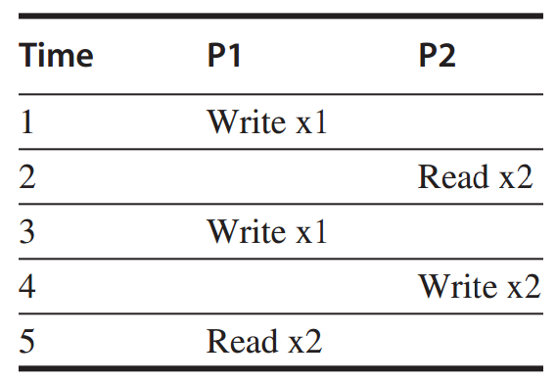
Coherence Miss
Example
assume words x1 and x2 are in the same cache block, which is in shared state in the caches of both P1 and P2.
identify each miss as a true sharing miss, a false sharing miss, or a hit?
Notes:
P219 on 4th edition

Slide 84
Coherence Miss
Example
1. true sharing miss
since x1 was read by P2 and needs to be invalidated from P2
Notes:
Follow the first case in the definition of true sharing miss:
first write by a processor to a shared cache block (causes an invalidation to establish ownership of that block)

Slide 85
Coherence Miss
Example
2. false sharing miss
since x2 was invalidated by the write of x1 in P1,
but that value of x1 is not used in P2;

Slide 86
Coherence Miss
Example
3. false sharing miss
since the block is in shared state, need to invalidate it to write;
but P2 read x2 rather than x1;

Slide 87
Coherence Miss
Example
4. false sharing miss
need to invalidate the block;
P2 wrote x2 rather than x1;

Slide 88
Coherence Miss
Example
5. true sharing miss
since the value being read was written by P2 (invalid -> shared)
Notes:
remaining content related to performance in Chapter 5.3 to be included in subsequent lectures

Slide 89
Outline
Multiprocessor Architecture
Centralized Shared Memory
Distributed Shared Memory

Slide 90
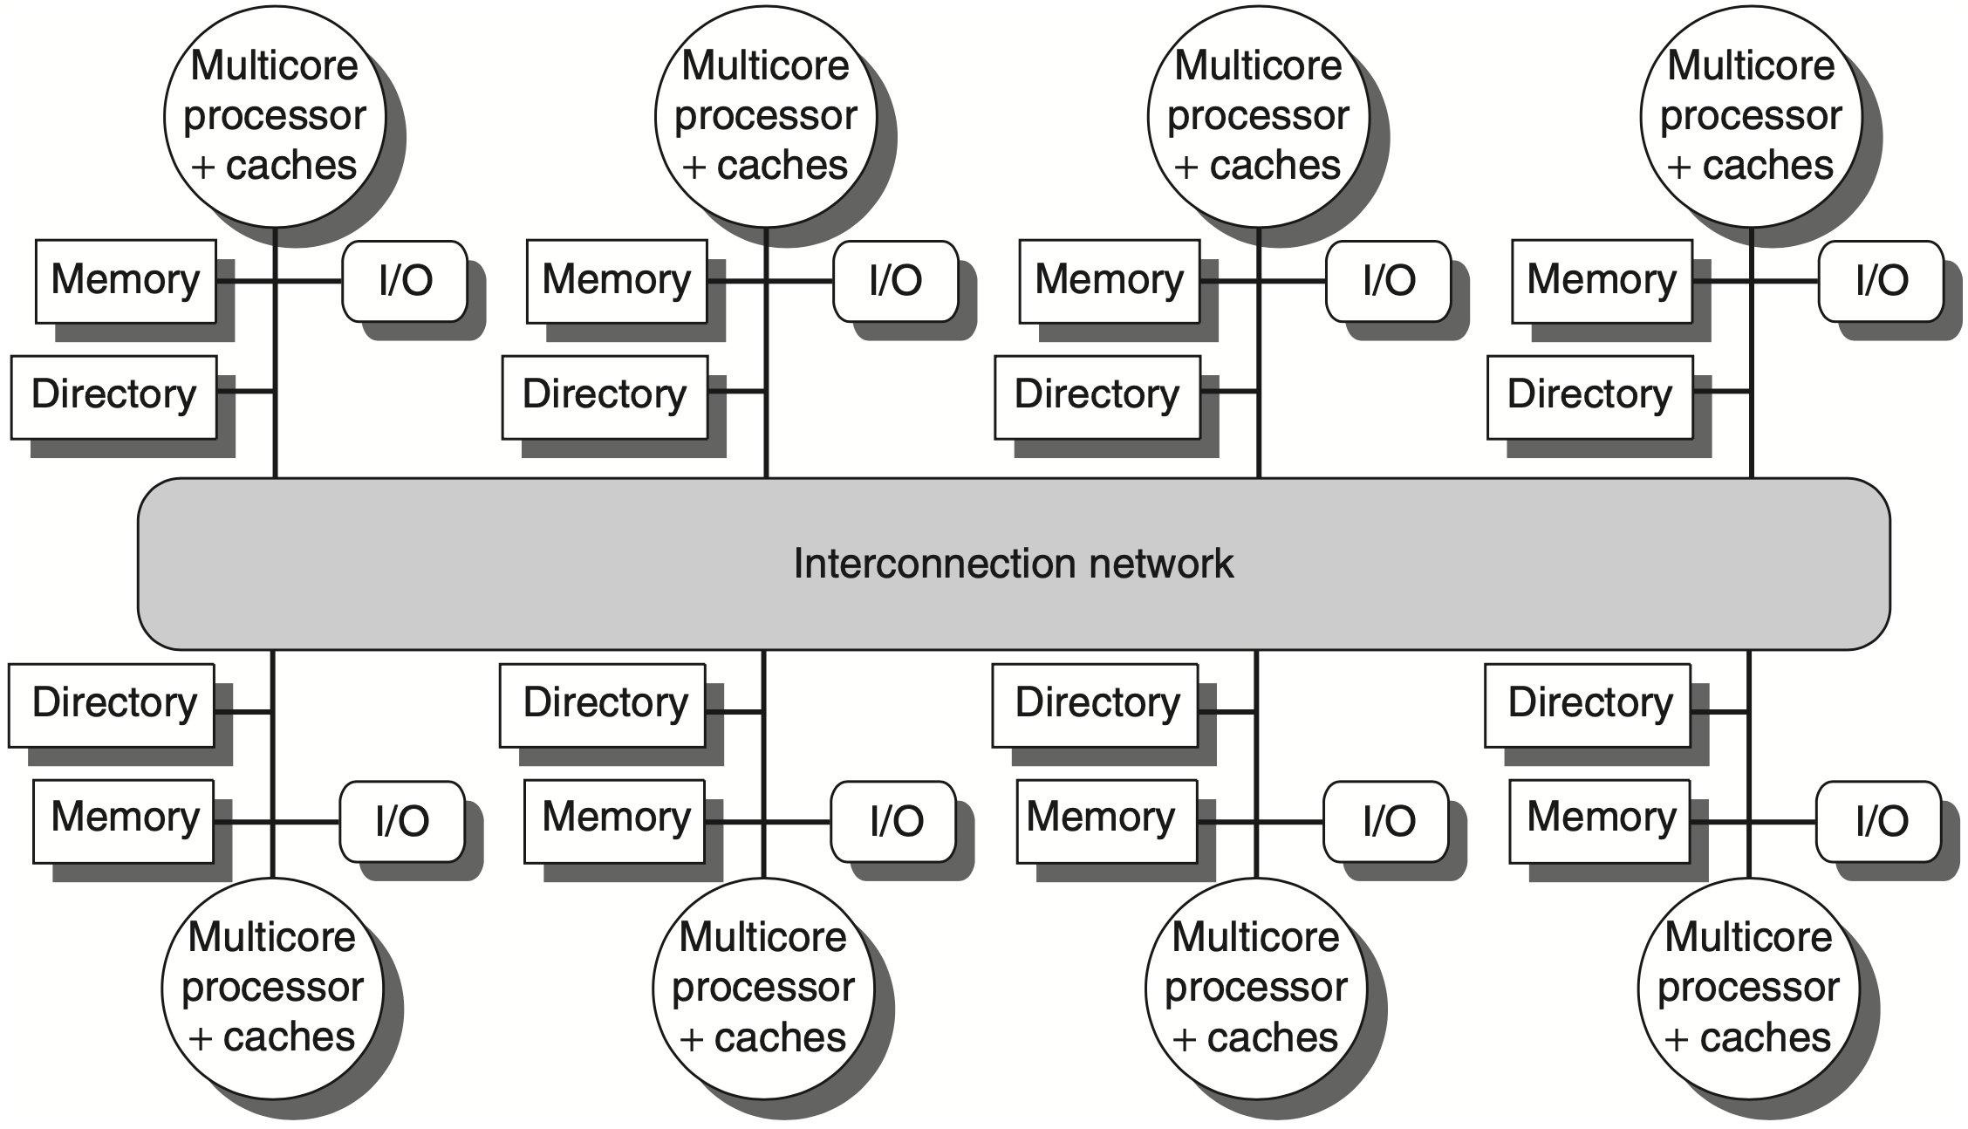
A directory is added to each node;
Each directory tracks the caches that share the memory addresses of the portion of memory in the node;
Notes:
A directory is added to each node to implement cache coherence in a distributed-memory multi- processor. In this case, a node is shown as a single multicore chip, and the directory information for the associated memory may reside either on or off the multicore. Each directory is responsible for tracking the caches that share the memory addresses of the portion of memory in the node. The coherence mechanism would handle both the main- tenance of the directory information and any coherence actions needed within the multicore node.

Slide 91
A directory is added to each node;
Each directory tracks the caches that share the memory addresses of the portion of memory in the node;
need not broadcast on every cache miss as in snooping-based coherence protocol

Slide 92
Directory-based Cache Coherence Protocol
Common cache states
Shared
one or more nodes have the block cached, and the value in memory is up to date (as well as in all the caches)
Uncached
no node has a copy of the cache block
Modified
exactly one node has a copy of the cache block, and it has written the block, so the memory copy is out of date

Slide 93
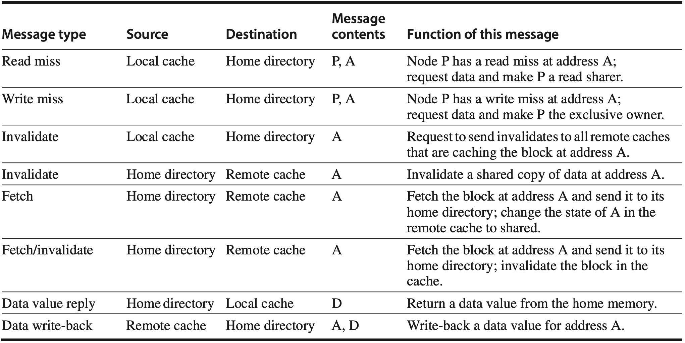
Directory-based Cache Coherence Protocol
P: requesting node number A: requested address D: data contents
Notes:
Figure 5.19 The possible messages sent among nodes to maintain coherence, along with the source and des- tination node, the contents (where P 5 requesting node number, A 5 requested address, and D 5 data contents), and the function of the message. The first three messages are requests sent by the local node to the home. The fourth through sixth messages are messages sent to a remote node by the home when the home needs the data to satisfy a read or write miss request. Data value replies are used to send a value from the home node back to the requesting node. Data value write-backs occur for two reasons: when a block is replaced in a cache and must be written back to its home memory, and also in reply to fetch or fetch/invalidate messages from the home. Writing back the data value whenever the block becomes shared simplifies the number of states in the protocol because any dirty block must be exclusive and any shared block is always available in the home memory.

Slide 94
Directory-based Cache Coherence Protocol
P: requesting node number A: requested address D: data contents
Notes:
The first three messages are requests sent by the local node to the home.

Slide 95
Directory-based Cache Coherence Protocol
P: requesting node number A: requested address D: data contents
Notes:
Data value replies are used to send a value from the home node back to the requesting node.

Slide 96
Directory-based Cache Coherence Protocol
P: requesting node number A: requested address D: data contents
Notes:
A remote node is the node that has a copy of a cache block, whether exclusive (in which case it is the only copy) or shared.
The fourth through sixth messages are messages sent to a remote node by the home when the home needs the data to satisfy a read or write miss request.

Slide 97
Directory-based Cache Coherence Protocol
home node reads a block invalidated by a remote node
P: requesting node number A: requested address D: data contents
Notes:
A remote node is the node that has a copy of a cache block, whether exclusive (in which case it is the only copy) or shared.
The fourth through sixth messages are messages sent to a remote node by the home when the home needs the data to satisfy a read or write miss request.

Slide 98
Directory-based Cache Coherence Protocol
home node writes and invalidates a block invalidated by a remote node
P: requesting node number A: requested address D: data contents
Notes:
A remote node is the node that has a copy of a cache block, whether exclusive (in which case it is the only copy) or shared.
The fourth through sixth messages are messages sent to a remote node by the home when the home needs the data to satisfy a read or write miss request.

Slide 99
Directory-based Cache Coherence Protocol
P: requesting node number A: requested address D: data contents
Notes:
A remote node is the node that has a copy of a cache block, whether exclusive (in which case it is the only copy) or shared.
The fourth through sixth messages are messages sent to a remote node by the home when the home needs the data to satisfy a read or write miss request.
Data value write-backs occur for two reasons: when a block is replaced in a cache and must be written back to its home memory, and also in reply to fetch or fetch/invalidate messages from the home. Writing back the data value whenever the block becomes shared simplifies the number of states in the protocol because any dirty block must be exclusive and any shared block is always available in the home memory.

Slide 100
Write Invalidate Protocol
how do states transit?

Slide 101
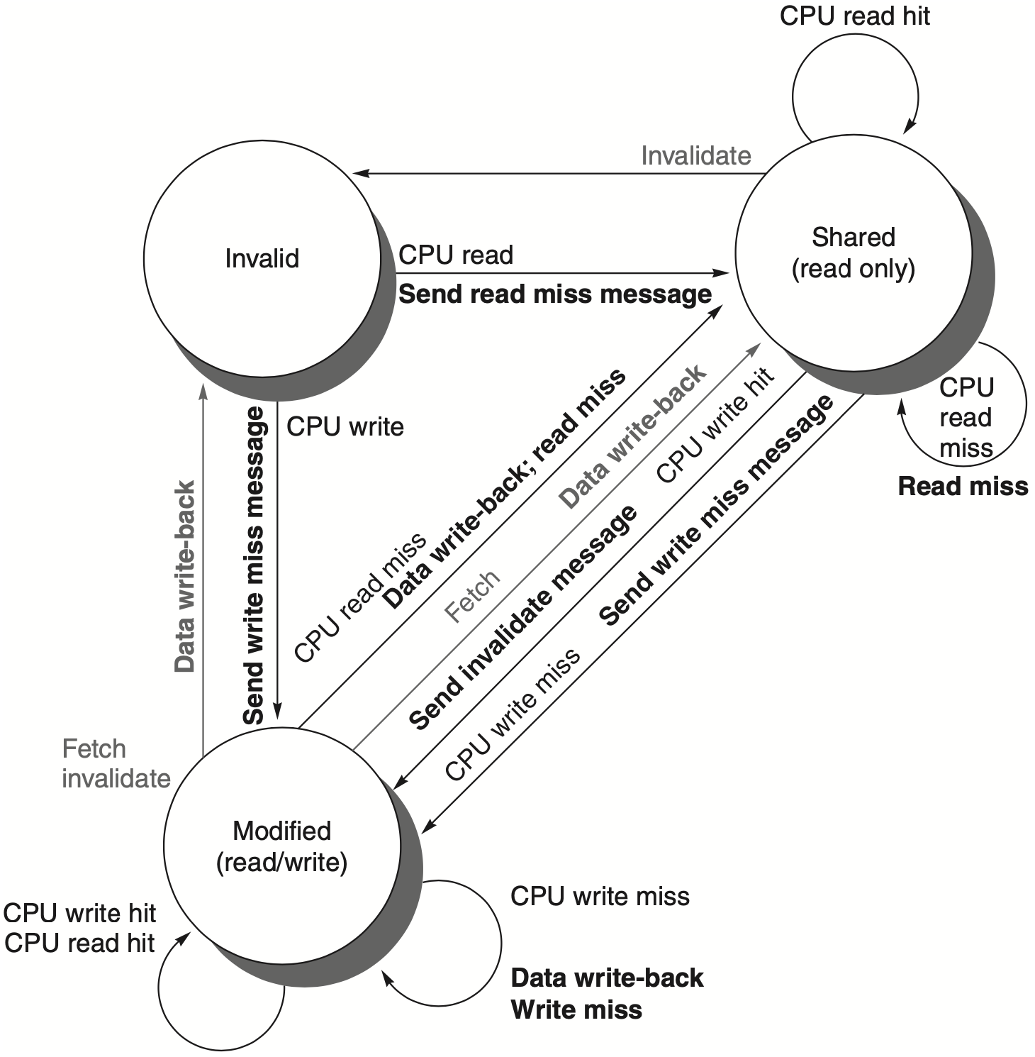
Directory Protocol
state transition diagram
for an individual cache block
requests from outside the node in gray
Notes:
Figure 5.20 State transition diagram for an individual cache block in a directory-based system. Requests by the local processor are shown in black, and those from the home directory are shown in gray. The states are identical to those in the snooping case, and the transactions are very similar, with explicit invalidate and write-back requests replacing the write misses that were formerly broadcast on the bus.
As we did for the snooping controller, we assume that an attempt to write a shared cache block is treated as a miss; in practice, such a transaction can be treated as an ownership request or upgrade request and can deliver ownership without requiring that the cache block be fetched.

Slide 102
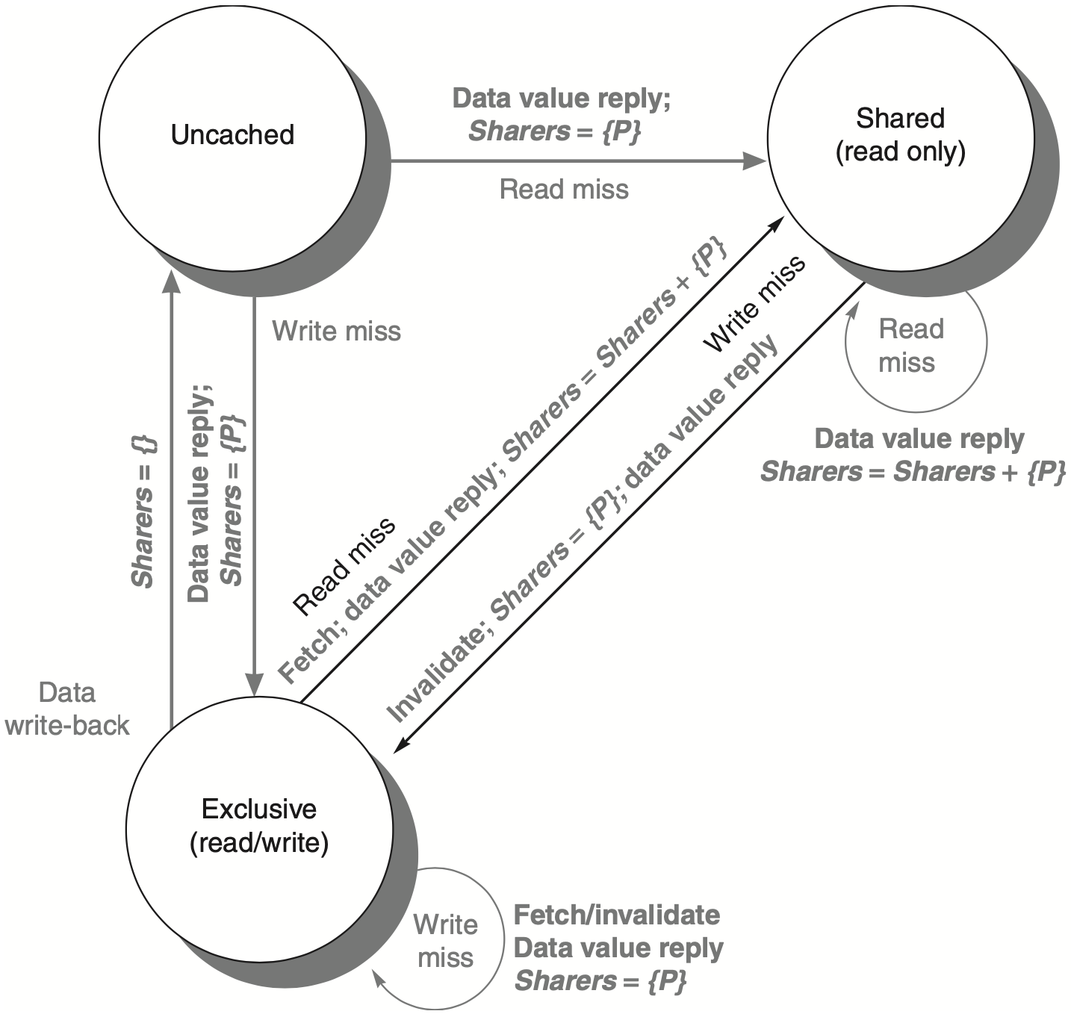
Directory Protocol
state transition diagram
for the directory
all actions in gray
because they’re all externally caused
Notes:
Figure 5.21 The state transition diagram for the directory has the same states and structure as the transition diagram for an individual cache. All actions are in gray because they are all externally caused. Bold indicates the action taken by the directory in response to the request.

Slide 103
Review
Mutiprocessor architecture
Cache coherence
Write invalidate protocol
Write update/broadcast protocol
MSI/MESI/MOESI protocol
True/false sharing miss
Directory-based cache coherence protocol

Slide 104
Chapter 5.1–5.4
Notes:
All these contents can be found in Chapter 5.

Slide 105
?

Slide 106

Thank You
don’t stop believin’
there’s no in-between,
take it to extreme.

Slide 107
#What’s More
Don’t Stop Believin’ / All Or Nothing /
Loser Like Me / I Lived /
Wake Me Up / Stand / Brave /
Defying Gravity / Breakaway /
Roots Before Branches / Not The End
Notes:
zz
“Glee是一首献给梦想家的颂歌，为那些时刻闪耀的梦想，为那些不辍追求的人们。”
https://www.bilibili.com/video/av6346876

